Slide 1
ISLAND Hopping in 2024

Slide 2
Lot’s of water

Slide 4
Where oh where will it be?

Slide 5
Across the Atlantic to Tampere, Finland
Week of August 26, 2024 (final date TBD)
Co-hosted by University of Tampere TACCU
Modern conference center in the new NOKIA Arena
Details will be coming … stay tuned
Coordinated with other accessibility events
Tervetuloa Suomeen!
(Welcome to Finland!)

Slide 6
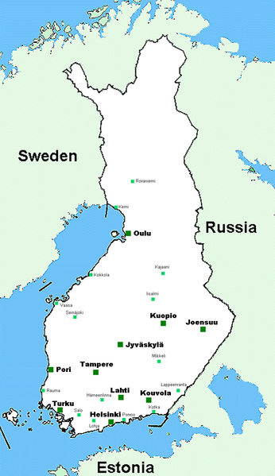
ISLAND 2024
Inclusion in Science Learning, a New Direction, conference
on disability and STEM
Making accessibility the new norm

